Slide 1
Predicting Research that will be Cited in Policy Documents
Rahul Pothireddy (z1829984)
Aravind Muvva (z1835959)

Slide 2
Index
Introduction
Previous Work
Initial steps
Missing Values
Data Preprocessing
Jumping in
Coefficients
Basic Terms
Regressions and Analysis
Multiple Linear Regression
Logistic Regression
Polynomial Regression of degree 2 and 3
Random Forest Regression
Summary
Future Work
Conclusion

Slide 3
INTRODUCTION
Scientific publications and other genres of research output are increasingly being cited in policy documents. Citations in documents of this nature could be considered a critical indicator of the significance and societal impact of the research output.
In order to make predictions we used features related to online attention. The dataset for this study is a dataset that we obtained from altmetric.com which had 5.2 million articles. In our analysis ,out of these articles 89,350articles have been cited in atleast one policy documents and the rest had not been included in the document of this kind. So to create a balanced dataset we chose 89,350 articles that had not been cited in a policy document.
The previous study of classification models determine that out of the three classifiers that were executed i.e, multiple naïve bayes classifier, random forest classifier and a c- support vector machine with radial basis function kernel, Random forest classifier showed better results in making predictions.
Policy documents influence large sections of society. Because of the unique importance of policy documents across diverse organizations, citations included in this type of material support both the credibility of the author cited and the credibility of the policy document itself.

Slide 4
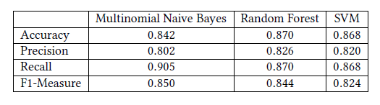
Previous Work
The previous study of classification models determine that out of the three classifiers that were executed i.e, multiple naïve bayes classifier, random forest classifier and a c- support vector machine with radial basis function kernel.
The evaluation of classifiers is based on their accuracy, precision and recall values.
Random Forest and multiple naïve bayes classifier performs better on overall analysis.
And finally it is concluded that random forest classifier slightly overperforms naïve bayes and showed better results in making predictions.

Slide 5
INITIAL STEPS
In order to make predictions we used features related to online attention. The dataset for this study is a dataset that we obtained from altmetric.com which had 5.2 million articles. In our analysis ,out of these articles 89,350 articles have been cited in at least one policy documents and the rest had not been included in the document of this kind. So to create a balanced dataset we chose 89,350 articles that had not been cited in a policy document.
The dataset has a very rich set of features for each article. However, in our analysis, we consider only features related to online attention.
We use mention counts on twitter, facebook, reddit, Mendeley, google plus, Wikipedia, weibo, news, blogs, videos and peer review sites as features to build our models.

Slide 6
Missing Values ? ? ?
Of course now comes the issue of missing values.
In each set of record there were few missing values (no value at all-empty field).
If we start programming with that dataset we get an error of NaN - standing for not a number, is a numeric data type value representing an undefined or un representable value.
Therefore we had to take certain steps or measures to make this empty fields be filled with a value of 0. Lets discuss this as a part of data preprocessing.

Slide 7
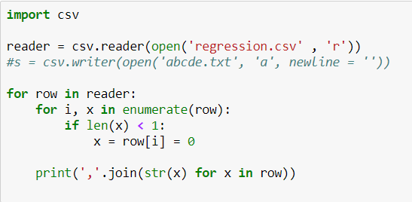
Data Preprocessing :
There are many types to clean and preprocess the data, like filling the missing values manually, considering the mean or median.
We chose to fill the missing values with zero. The below is code for it.

Slide 8
JUMPING IN
Regression : According to statistics, regression means a measure of the relation between the mean value of one variable (e.g., output) and corresponding values of other variables (e.g., time and cost).
Regression Analysis : The analysis or measure of the association between one variable(the dependent variable) and one or more other variables (the independent variables), usually formulated in an equation in which the independent variables have parametric coefficients, which may enable future values of the dependent variable to be predicted.
Y_{i} = b₀ + b₁x
In our project we have performed Simple linear Regression, Polynomial regression of degree 2 and polynomial regression of degree 3, logistic regression and Random Forest regression.
So let us now get a gist of the all the above regressions performed.

Slide 9
FEATURES | CORRELATION COEFFICIENT
Peer_reviews | 0.5641
Googleplus | 0.0260
reddit | 0.1696
video | 0.3362
Twitter | 0.0227
Weibo | 0.0876
Mendeley | 0.0268
Wikepedia | 0.0931
Blogs | 0.0686
Facebook | 0.0682
news | 0.0151

Slide 10
Basic Terms
Precision is the fraction of relevant instances among the retrieved instances.
Recall is the fraction of relevant instances that have been retrieved over the total amount of relevant instances.
F₁ score (also F-score or F-measure) is a measure of a test's accuracy. It considers both the precision p and the recall r of the test to compute the score.
Accuracy : the degree to which the result of a measurement, calculation, or specification conforms to the correct value or a standard.
A correlation coefficient is a numerical measure of some type of correlation, meaning a statistical relationship between two variables. The variables may be two columns of a given data set of observations, often called a sample, or two components of a multivariate random variable with a known distribution.

Slide 11
Multiple Linear Regression : In simple linear regression a single independent variable is used to predict the value of a dependent variable.
To test the usability of features presented, a multiple linear regression was employed. All the 11 features present in the dataset have been used in order to establish a linear relationship between 11 independent features.
We used all 178,620 records of data to perform multiple linear regression. The data is split into test and train subsets (80% tests and 20% train). The data is then shuffled multiple times.
Since the test and train data has more than 1 independent variable, we listed the results for each feature seperately using prediction and observed data points.

Slide 12
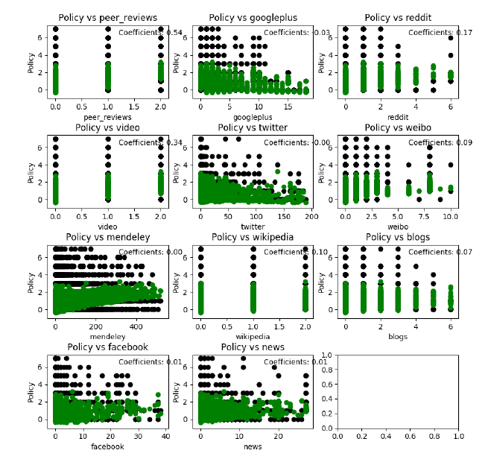
Prediction result using linear regression for each feature. Test data is in black and predicting data is in green.

Slide 13
Results obtained
Mean Error | 1.94
R² Value | 0.09
We observed that the r2 value is quite low and also the mean error is relatively high. So in order to get netter results we have removed outliers using z score for data points greater than 3 .
After removing the outliers we got the results as follows.
Mean Error | 0.42
R2 Value | 0.36
Precission | Recall | F1 Measure
0.65 | 0.69 | 0.63
Accuracy
66%

Slide 14
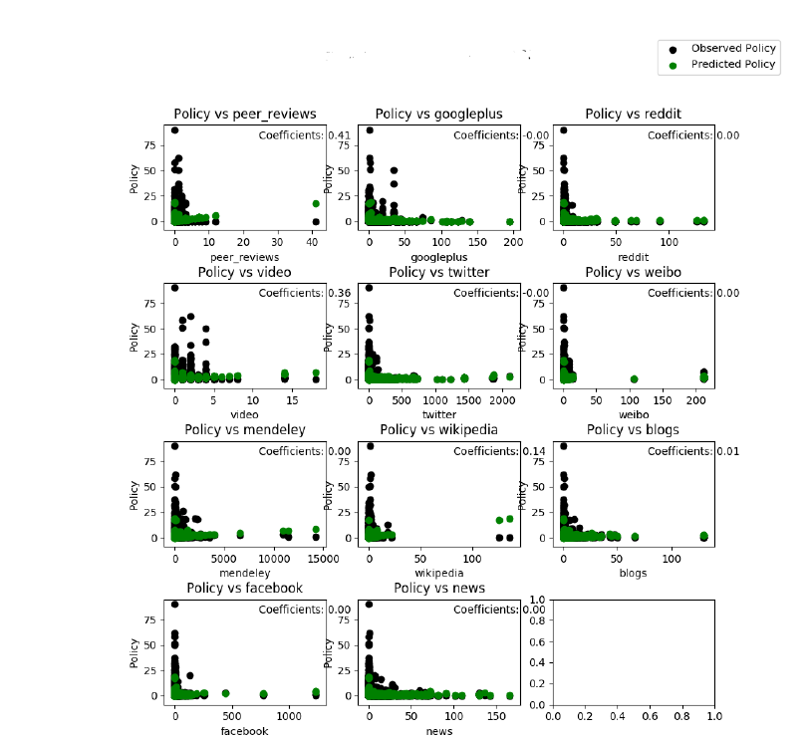

Slide 15
Logistic Regression The logistic regression is a predictive analysis. Logistic regression is used to describe data and to explain the relationship between one dependent binary variable and one or more nominal, ordinal, interval or ratio-level independent variables.
Mean Square Error | 0.49
R² Value | 0.30
AVERAGE VALUES
Precission | Recall | F1 measure | Accuracy
0.75 | 0.82 | 0.78 | 81.8%

Slide 16
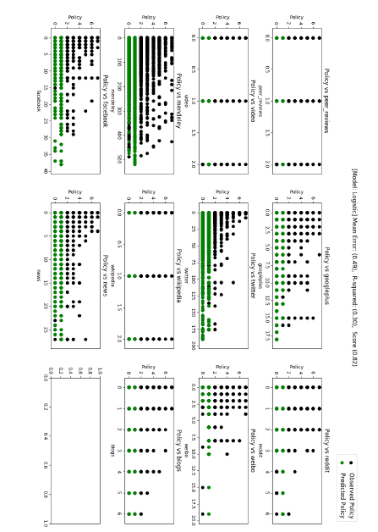

Slide 17
Now we performed logistic regression to know the results and it turns out to be a “not good” case in terms of prediction.
The reason is that it has relatively high mean square error followed by low r² value.

Slide 18
Polynomial Regression
In statistics, polynomial regression is a form of regression analysis in which the relationship between the independent variable x and the dependent variable y is modelled as an nth degree polynomial in x.
Degree 2
Degree 3
Polynomial Degree 2
Mean Square Error | 0.38
R² value | 0.45
Average values
Precission | Recall | F1 measure | Accuracy
0.76 | 0.81 | 0.77 | 80.9%

Slide 19
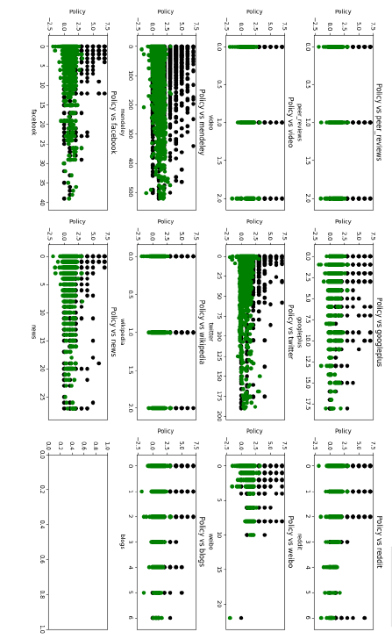
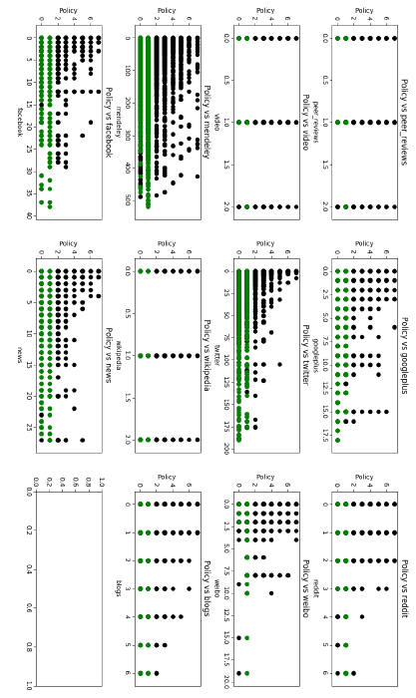
Degree2 Degree3

Slide 20
Polynomial Degree 3
Mean Square Error | 0.35
R2 Value | 0.50
Average Values
Precission | Recall | F1 measure | Accuracy
0.79 | 0.84 | 0.81 | 83.2%
Firstly we take dependent variable y modeled as second degree and then we take it in third degree.

Slide 21
Random Forest Regression
A random forest is a meta estimator that fits a number of classifying decision trees on various sub-samples of the dataset and use averaging to improve the predictive accuracy and control over-fitting.
The Random Forest is one of the most effective machine learning models for predictive analytics, making it an industrial workhorse for machine learning.
Mean Square Error | 0.34
R2 Value | 0.52
Precission | Recall | F1 value | Accuracy
0.84 | 0.88 | 0.86 | 88%

Slide 22
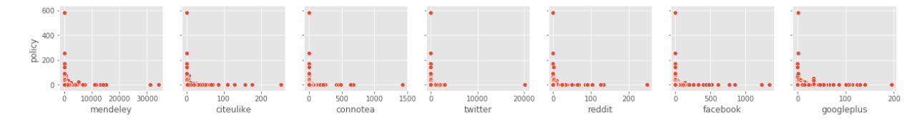
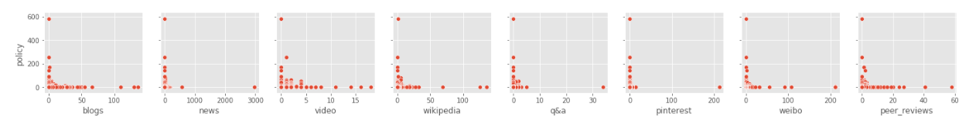

Slide 23
Summary
 | Mean Square Error | R2 value | Precission | Recall | F1 measure | Accuracy
Multiple Linear Reg. | 0.45 | 0.35 | 0.65 | 0.69 | 0.63 | 66%
Logistic Regression | 0.47 | 0.31 | 0.75 | 0.82 | 0.78 | 81.8%
Polynomial reg. deg 2 | 0.38 | 0.45 | 0.76 | 0.81 | 0.77 | 80.9%
Polynomial reg. deg 3 | 0.35 | 0.50 | 0.79 | 0.84 | 0.81 | 83.2%
Random Forest Reg. | 0.34 | 0.52 | 0.84 | 0.88 | 0.86 | 88%

Slide 24
CONCLUSION
In this study, we used a specific set of features that track online attention received by scholarly articles to build regression to predict the likelihood of an article being cited in public policy. The Random Forest Regression showed better results in making predictions. We found mention counts on peer-review platforms to be better correlated.
Concluding, the performance of each regression model is quite feasible, but the difference comes in the values of precision, recall and f1 measure, mainly the mean square error and r² value.
Although the values of polynomial regression of degree 3 and random forest regression are closely similar, we found that random forest is found to be the best among them as polynomial degree 3 shows high mean square error.

Slide 25
Future Work
In the current analysis we took the features related to online attention and predict whether the work has been cited in a policy document or not.
We intend to extend our work by considering more data and also more features and perform the classification and regression models on them to examine and compare the results.

Slide 26
Thank You

